Slide 2
Creating User Friendly Custom Connectors from Azure Functions
Jason Lattimer
Development Manager & Business Apps MVP
Venkat Rao
Business Apps Capability Manager
PowerObjects / HCL

Slide 3
PowerObjects is 100% focused on Microsoft Dynamics 365. Driving success for your end-to-end journey with our four pillars of service, support, education and add-ons.

Slide 4

PowerObjects’ Four Pillars
Delete this box before presenting

Slide 5

Custom Connectors
What is a custom connector?
Wrapper around an existing API
Work like the OOB connectors
Use with PowerApps, Flow, or Logic Apps
Why use a custom connector?
Connect to unique data sources / web services
Provide functionality that doesn’t exist natively

Slide 6
Making connectors user friendly
Meaningful names and descriptions
Accurate data types
Default values
Dynamic values (picklists)
Static values
Results from other connectors
Visibility (not hiding items under menus)
Responses / statuses

Slide 7

Using Azure Functions
Serverless – pay for what you use as you scale up
Code and test from online editor or Visual Studio
Can be written in multiple development languages
Ideal for smaller / shorter-running processes
Multiple security options

Slide 8
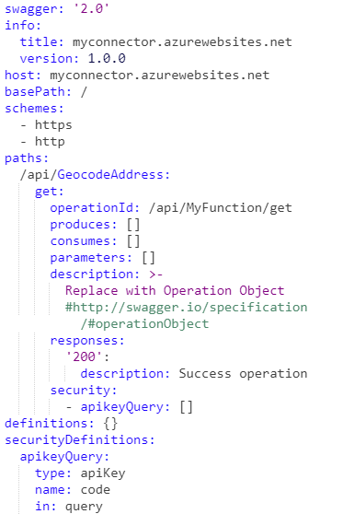
API definitions
Structures
Url, HTTP verb(s), security
Input parameters
Response content
Generating from Azure
Only provides the base template
Can’t natively be generated from code
Requires manual editing
Can be saved but changes are easily lost
Syntax & spacing is very picky

Slide 9
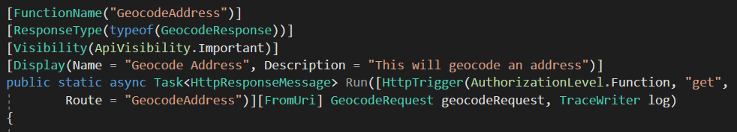
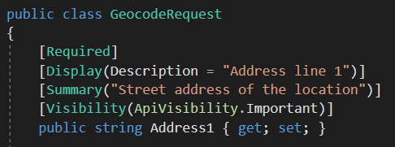
What developers can do
Use AzureFunction Swagger Definition Generator
https://github.com/wobba/AzureFunction-SwaggerDefinition
https://github.com/jlattimer/AzureFunction-SwaggerDefinition
Creates a new Azure Function that outputs the API definition based on code annotations
Aligns closely to schema exposed in OOB connectors
Use objects for parameters and responses
Annotate at method and parameter levels
Omit things that aren’t needed

Slide 10
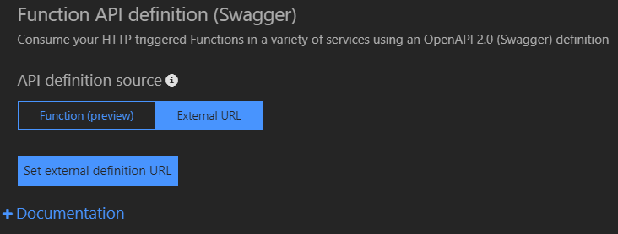
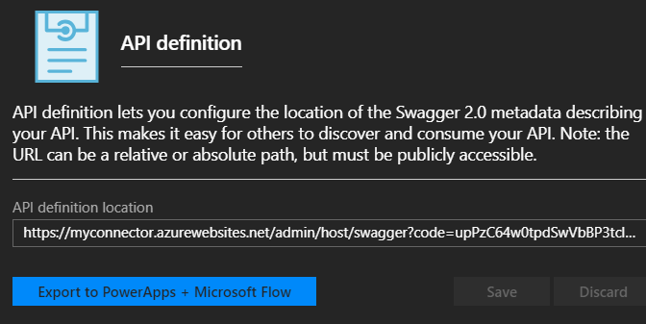
Generating a well documented definition
Point the External Definition Url to the Swagger Function
Save to file (ApiDef.json) and use to import into new custom connector

Slide 11
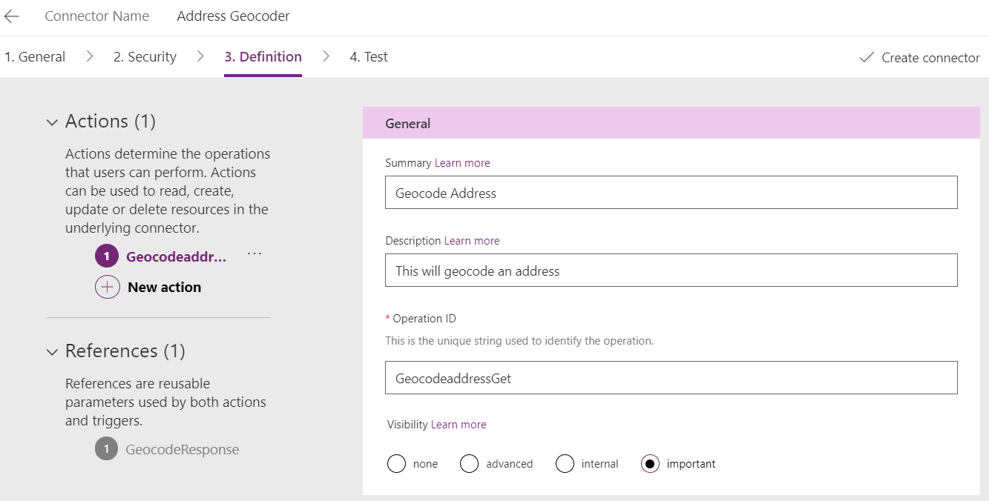
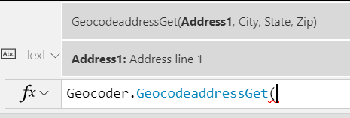
Custom Connector from OpenAPI file
Use ApiDef.json exported from Azure Function
All data pre-populated

Slide 12
Demo

Slide 13
The Road Warrior: A PowerApps App For Your Field Staff
Venkat Rao – Capability Manager, Business Applications
PowerObjects / HCL

Slide 14
Pain Points For Field Employee
Too many swipes & clicks
Finding information is not easy
App slows me down

Slide 15
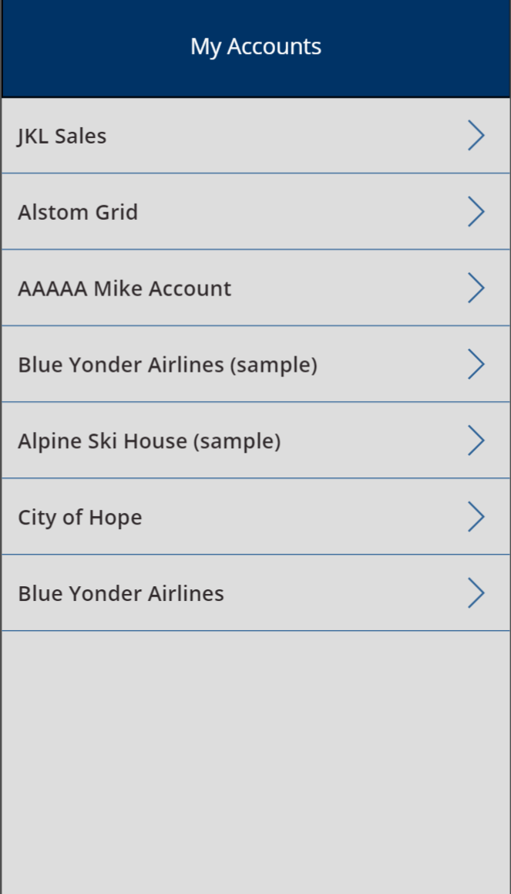
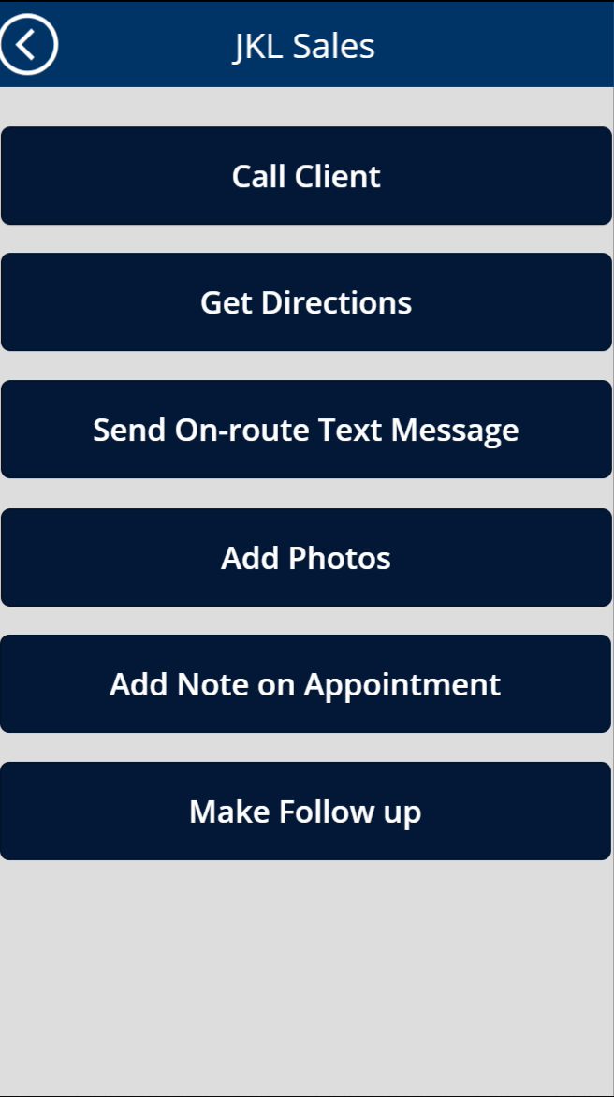
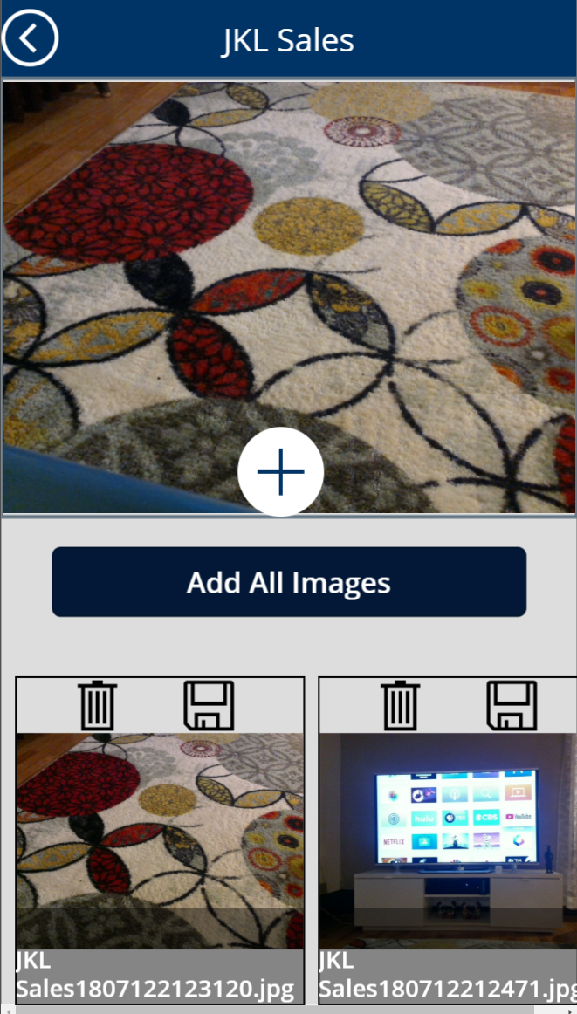
Enter: The Road Warrior!
Home screen shows accounts
Single click to get directions, call, text, take photos, add note, create follow up appointment

Slide 16
Demo & App Formulas

Slide 17
Video

